Slide 1
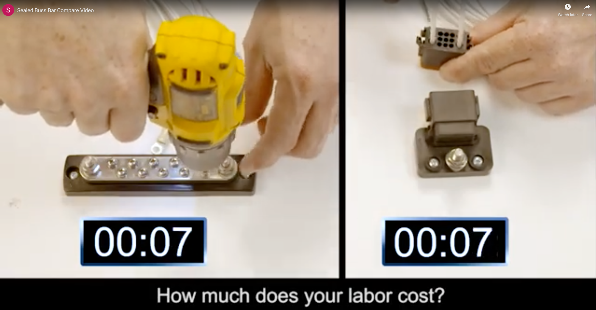

Slide 2
Video

